Slide 1


http://teachertapp.co.uk/get-the-app/

Slide 2


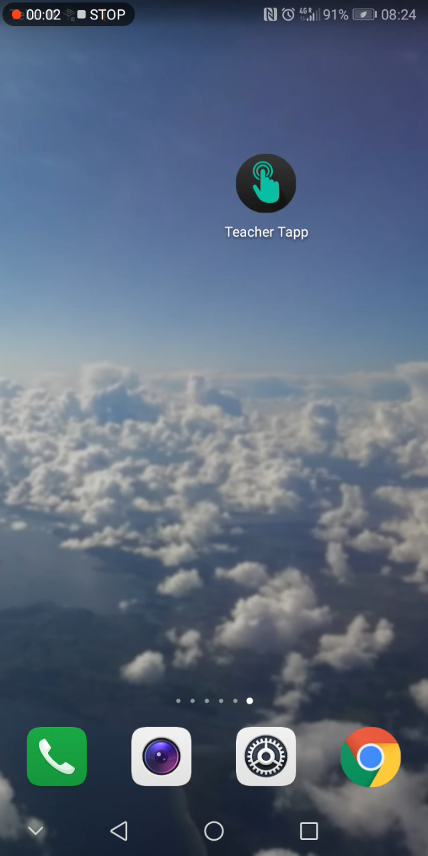
🔔 You have new questions
STEP ONE – ASK
Ever wondered whether what goes on in your school is ‘normal’? We work with teachers, researchers and other organisations to craft three multiple choice questions for the panel and load them onto our system.
STEP TWO – ANSWER
At 3:30pm, phones across the country buzz and you get a chance to answer our three questions. Most teachers are super-quick, answering in the first hour!

Slide 3

STEP THREE – LEARN
Once you’ve answered the three questions, you get to find out how other teachers answered yesterday’s questions
Share the findings on social media or by email

Slide 4
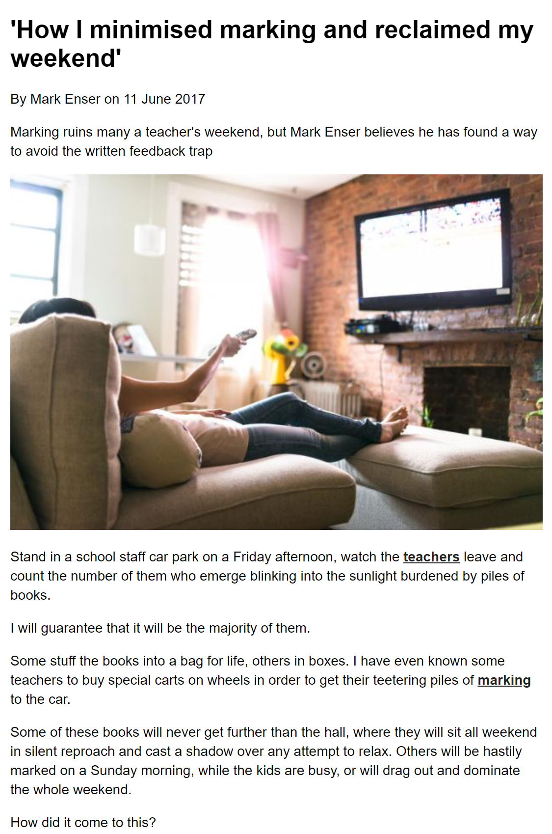
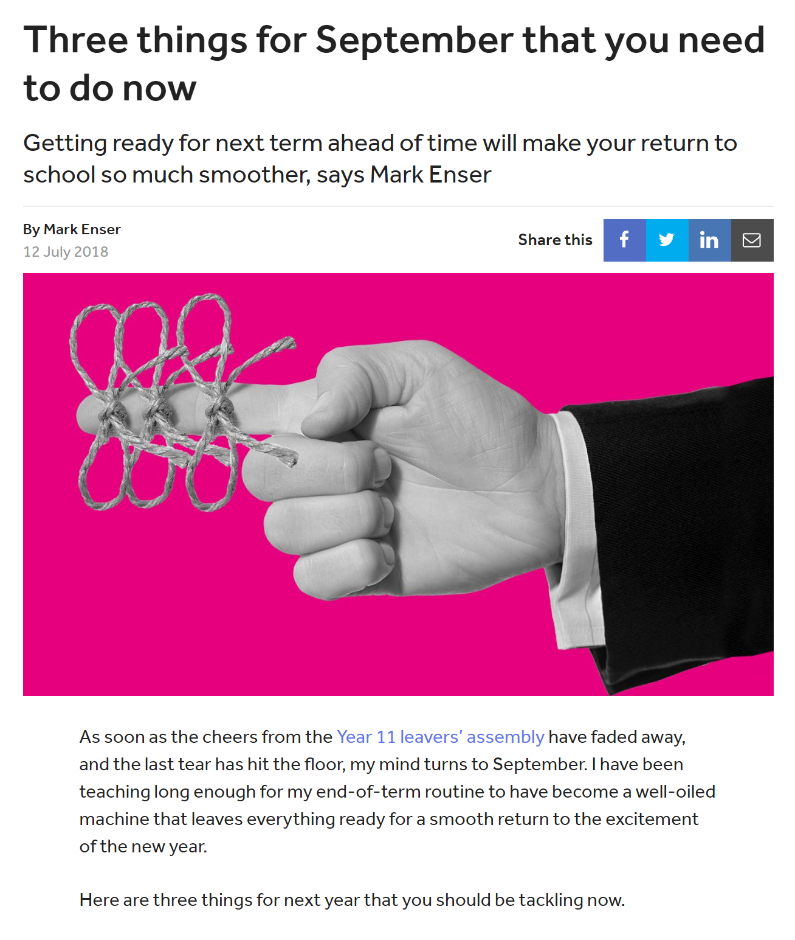

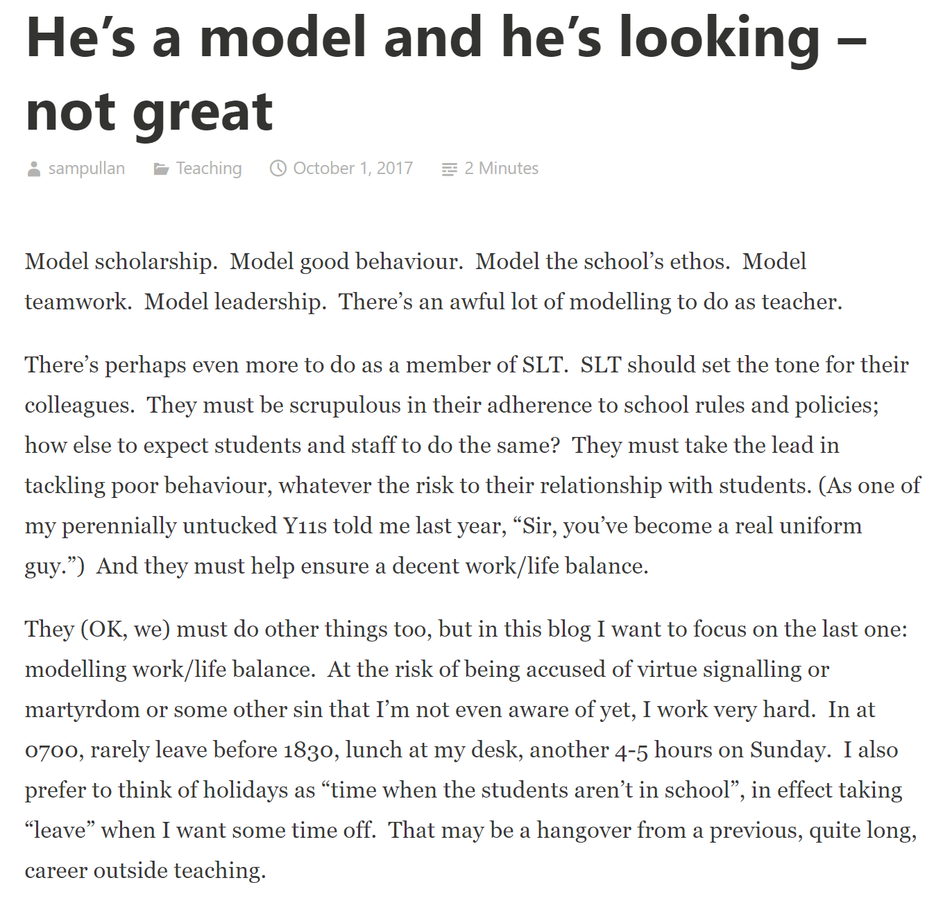
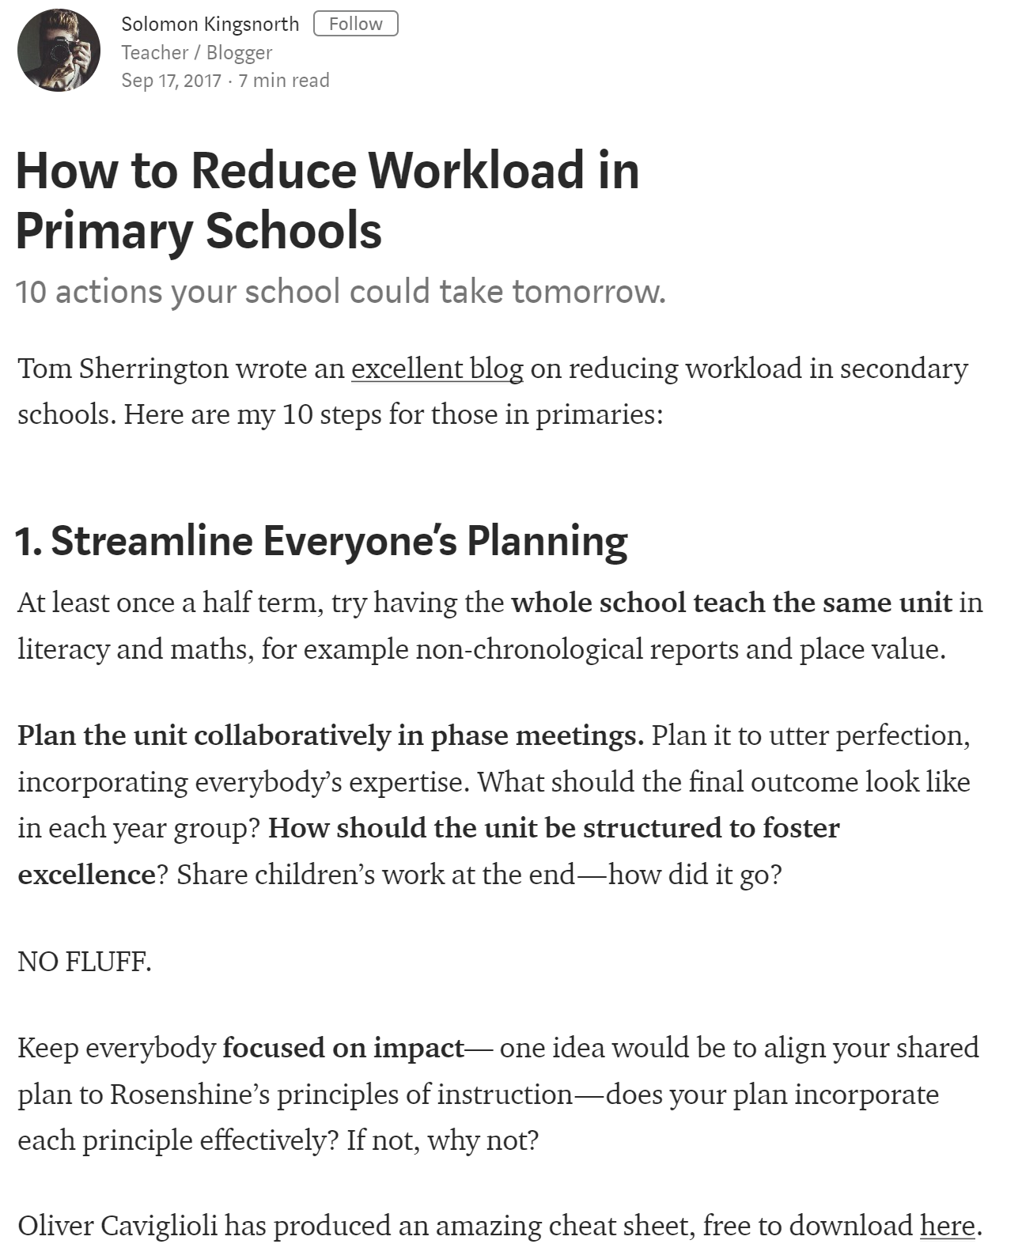
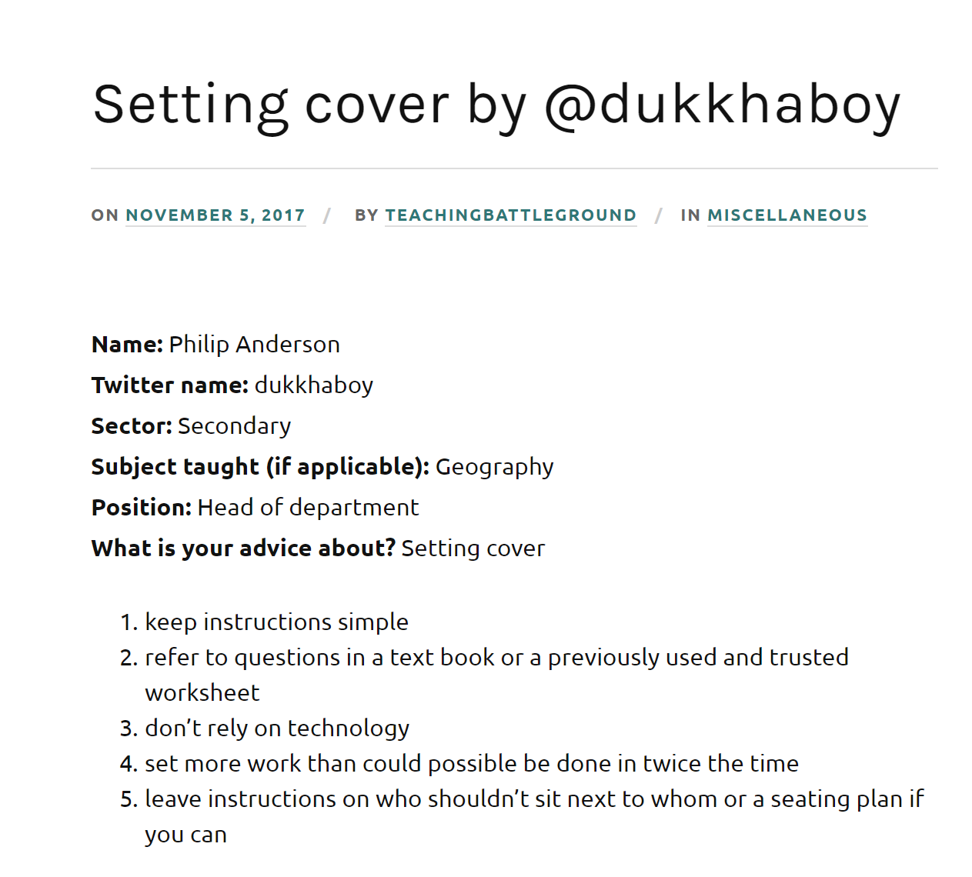
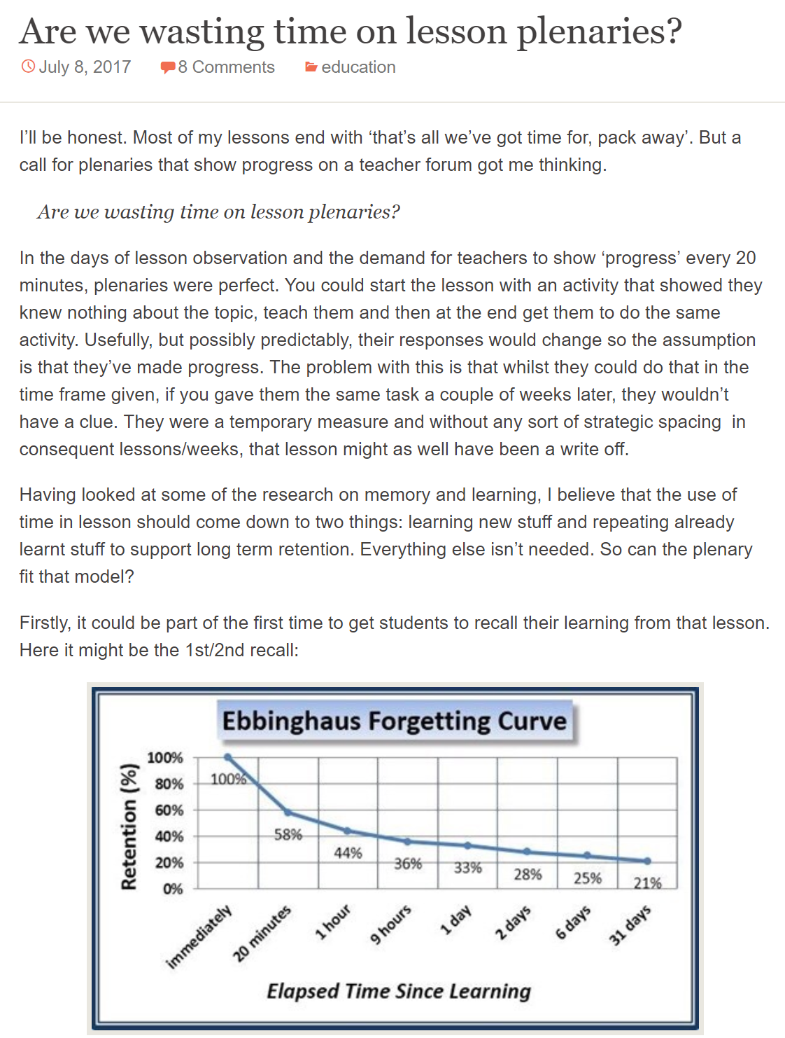
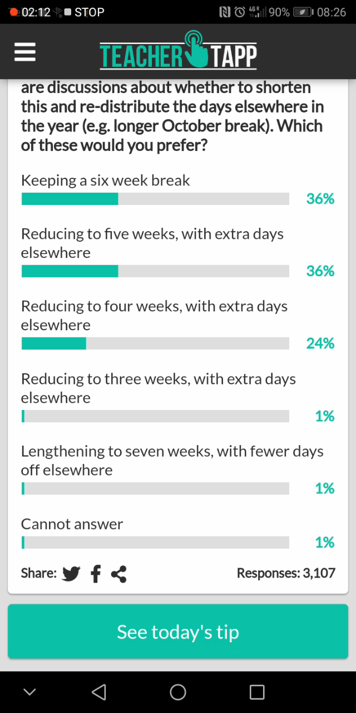
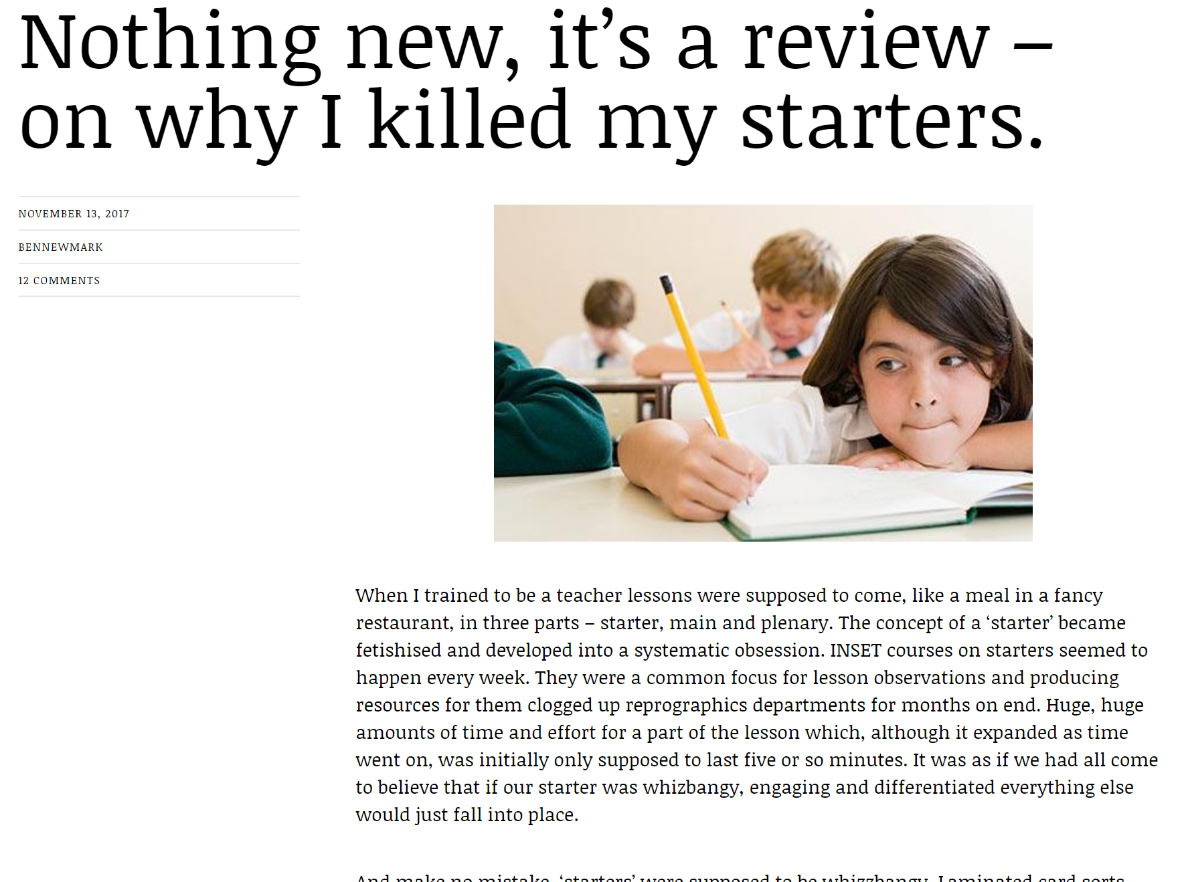
STEP FOUR – LEARN (MORE!)
We curate articles and blog posts for you to read every day to support your professional development.

Slide 5
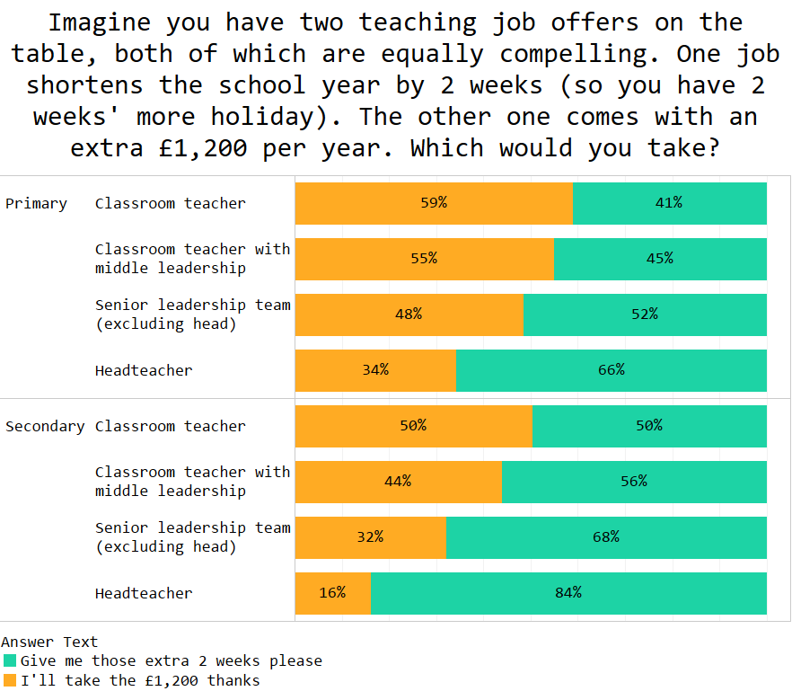
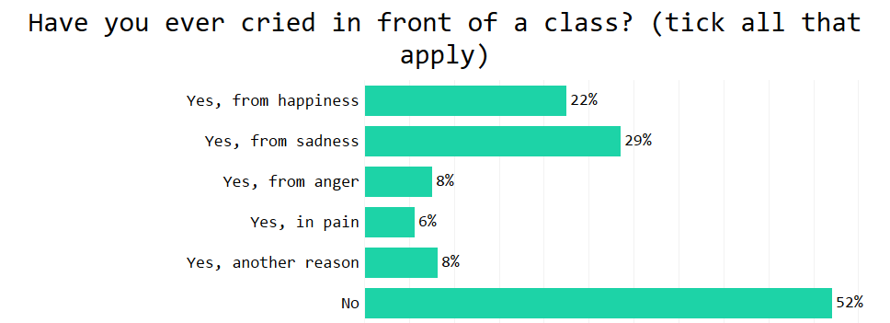
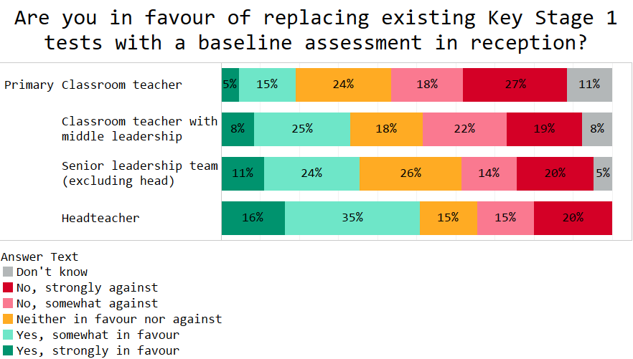
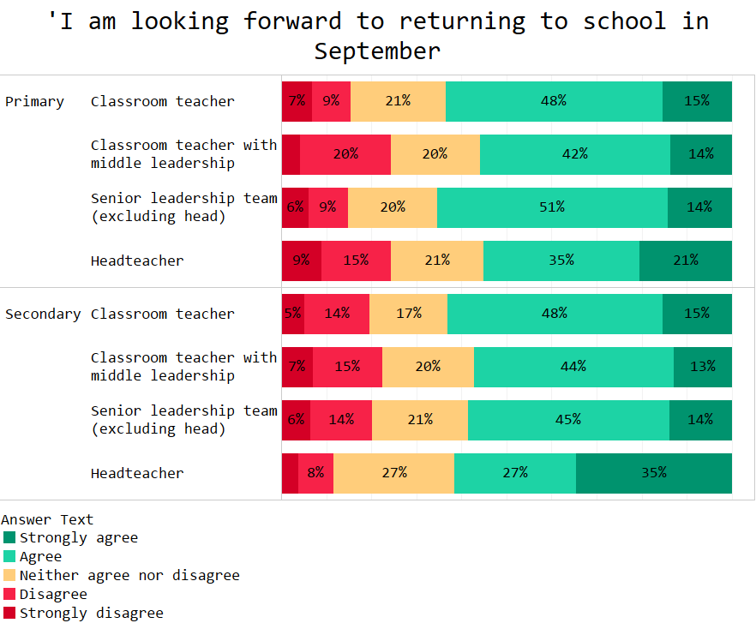
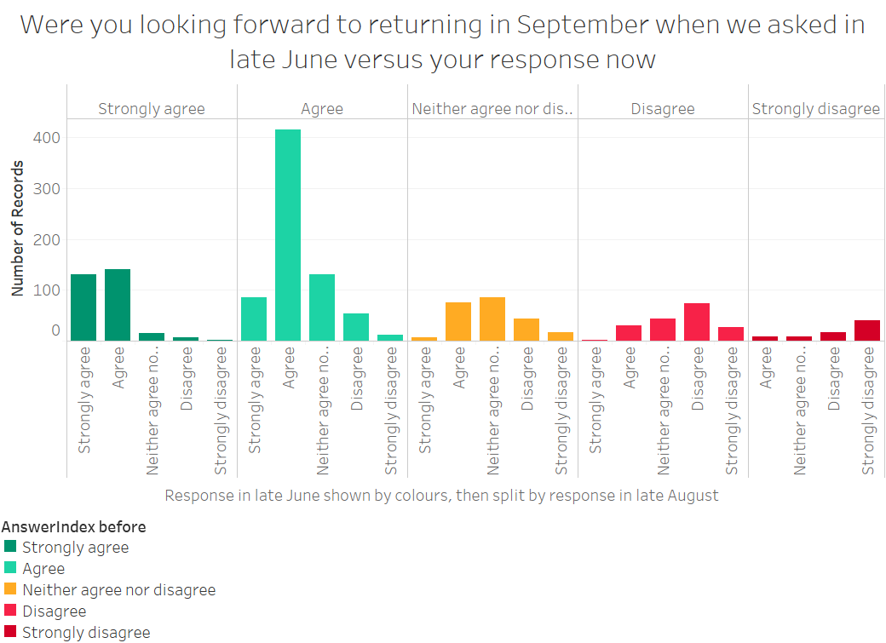
STEP FIVE – LEARN (EVEN MORE)
We harvest the data to create insights about schools and the profession, which we summarise in a weekly blog post

Slide 6

What’s in it for the teachers?
ENJOYABLE
PRO-SOCIAL
Asking and answering questions is fun!
It’s an easy and worthwhile way to end the day
LEARN
SHAREABLE
You’ll learn from our responses, tips and blogs
Questions and tips create conversation points across colleagues

Slide 7



By asking questions, sharing data, and researching outcomes we will be able to build a better-informed workforce that keeps teachers for longer
Download Teacher Tapp from your app store and start helping us make schools smarter!
http://teachertapp.co.uk/get-the-app/

